Slide 1
Boulder Bicycle
Images of BCycle station + Logo + CU Boulder logo + Teammates images
Team introduction- CUB Data Science students.
Talk: Problem statement in short- we are aiming to predict the bike wait time in Boulder BCycle station.
Take the above statement and hover through each part of it and breakdown in upcoming slides

Slide 2



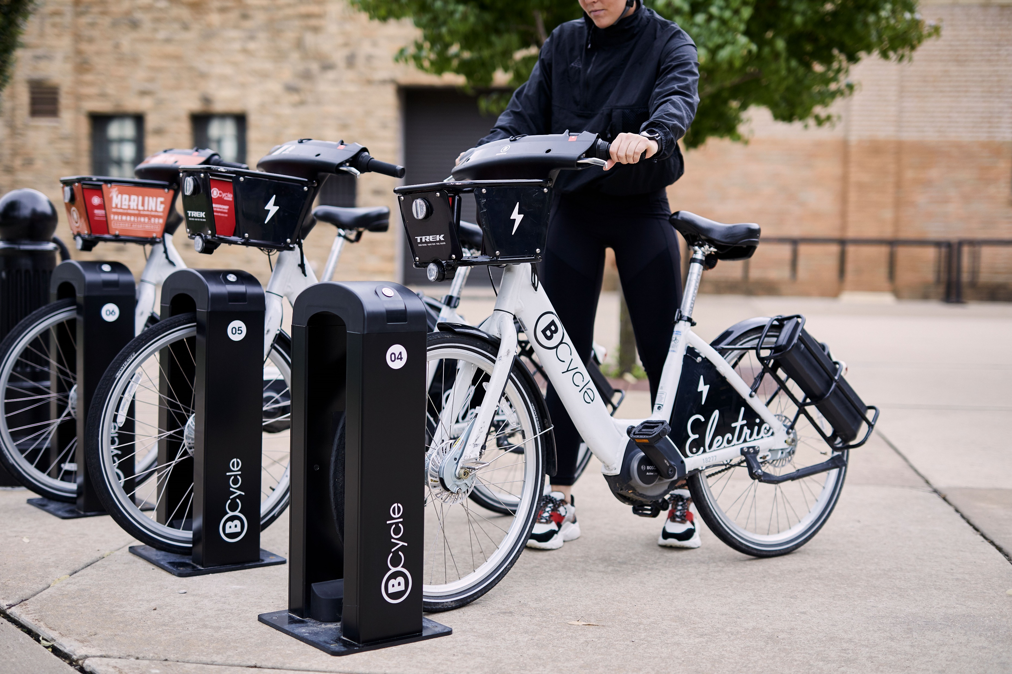
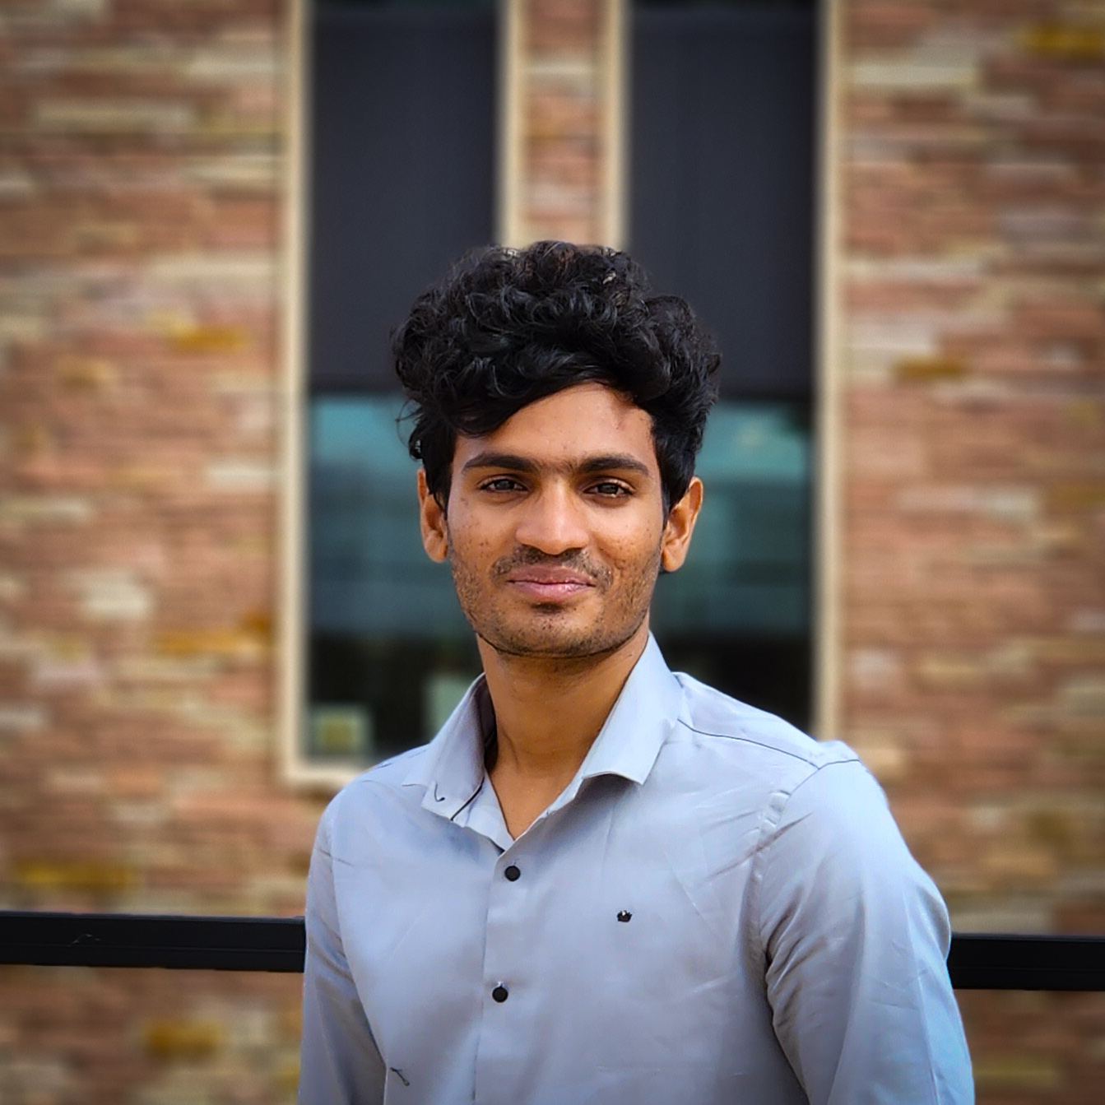




Dock Watch
Objective: Estimate the bicycles waiting period at the Boulder BCycle stations.
Public bicycle sharing company
47
Locations across the U.S.
Niranjan Cholendiran
Santhosh PM
Notes:
Images of BCycle station + Logo + CU Boulder logo + Teammates images
Team introduction- CUB Data Science students.
Talk: Problem statement in short- we are aiming to predict the bike wait time in Boulder BCycle station.
Take the above statement and hover through each part of it and breakdown in upcoming slides
Myself Niranjan and Santhosh are going to present our project Dock Watch
We are CU Boulder Data Science masters students and this project is a part of CSCI ____ Data Mining course under Dr. Osita.
Agenda:
Objective breakdown
Data Collection and Data Flow Architecture

Slide 3
Objective: Estimate the bicycles waiting period at the Boulder BCycle stations.
Public bicycle sharing company
47
Locations across the U.S.
Notes:
Images of BCycle station + Logo + CU Boulder logo + Teammates images
Team introduction- CUB Data Science students.
Talk: Problem statement in short- we are aiming to predict the bike wait time in Boulder BCycle station.
Take the above statement and hover through each part of it and breakdown in upcoming slides
Myself Niranjan and Santhosh are going to present our project Dock Watch
We are CU Boulder Data Science masters students and this project is a part of CSCI ____ Data Mining course under Dr. Osita.
Agenda:
Objective breakdown
Data Collection and Data Flow Architecture

Slide 4
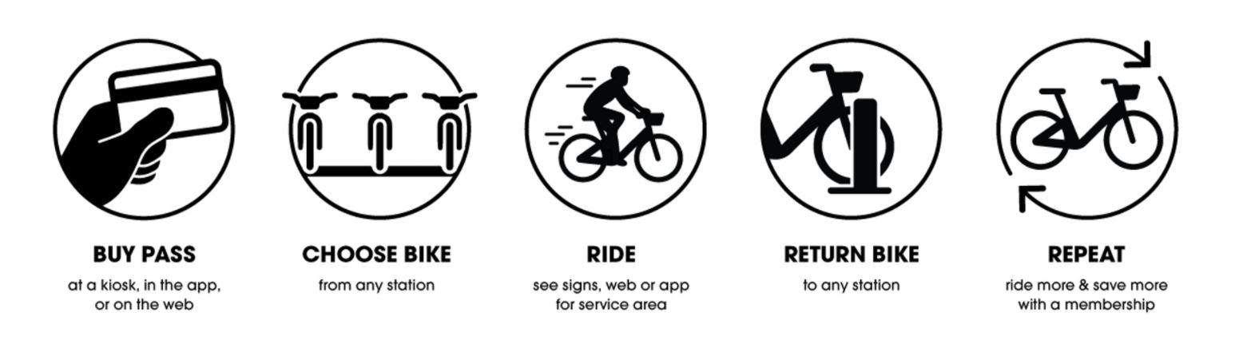

Objective: Estimate the bicycles waiting period at the Boulder BCycle stations.
Public bicycle sharing company
Membership Program
47
Locations across the U.S.
Mobile Application
Notes:
Public bicycle sharing company. Advantage is they provide electric bicycles- so it’s easier to pedal than regular bicycles.
Available in 47 cities across the U.S. There are multiple charging stations available in each city.
They provide membership program- where you can pay upfront and use the cycles for allotted time period.
There’s mobile application where you one can track the station locations, number of cycles available, etc

Slide 5

Objective: Estimate the bicycles waiting period at the Boulder BCycle stations.
Wait Time
< 20 mins | Very Low
20 – 40 mins | Low
40 – 60 mins | Moderate
> 60 mins | High
Public bicycle sharing company
Membership Program
47
Locations across the U.S.
Mobile Application
Notes:
Boulder BCycle is one of the most popular across all 47 cities.
Main reason is because they provide free membership to CU Boulder students, hence it is often used by CU students to commute between campus and their house.
I personally use it almost everyday, it saves my time waiting for public transports, if not I have to get 2 busess to reach the campus.

Slide 6
Objective: Estimate the bicycles waiting period at the Boulder BCycle stations.
Wait Time
< 20 mins | Very Low
20 – 40 mins | Low
40 – 60 mins | Moderate
> 60 mins | High
Notes:
The mobile app have does not have any information regarding how long one has to wait if the station is empty or have less number of bikes, so we want to bring in that feature.
Now, why is it important? Since it is very popular among students the popular stations often times runs out of bike so students have to wait without knowing if they’ll get one soon.
I personally have waited more than 30 mins and ended up not getting one.
That’s where this project kicks in- We aim is to analyze the usage trend of cycles at different stations and at different times, find a pattern, figure out the factors that influence the usage of cycles and use to build a ML model that can estimate the wait time at any point of the time.
This is a classification problem that’s gonna predict the wait time category starting from “very low” wait time if one can expect a new cycle in within 20mins to “very high” depicting more than an hour.
On an average, the wait time for public busses in Boulder is 30mins. So, if we can predict the cycle availability within 20mins accurately, then that’s gonna save a lot of time.
Hope the objective of our project is clear. Let’s now move on to the technical part of the project.

Slide 7







Data Flow Architecture
Freq: 3 mins
BCycle Station Status Data
EDA/ Visualization
Data Collection
Data Storage
Freq: 1 hour
Amazon EC2
Modeling
Temperature Data
Freq: 1 day
CU Class Status Data
Preprocessing Pipelines
Notes:
GBFS API (only provides live status) (Snapshot of the table) + Temperature data pull + CU Class status (Snapshot of the table)->
AWS EC2 instance ->
Store data in PostGrey ->
Collab preprocessing pipeline ->
[loop] Store data in Postgrey ->
Tableau + Collab Modelling

Slide 8
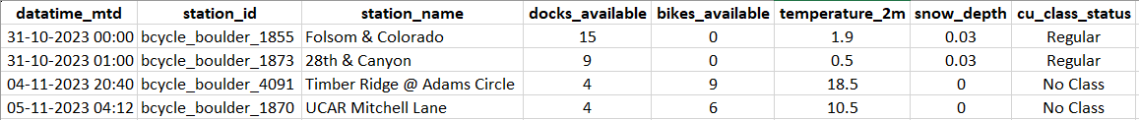
Data Flow Architecture
Freq: 3 mins
BCycle Station Status Data
EDA/ Visualization
Data Collection
Data Storage
Freq: 1 hour
Amazon EC2
Modeling
Temperature Data
Freq: 1 day
CU Class Status Data
Preprocessing Pipelines
Notes:
This is our complete data flow architecture: Strating from data collection to modelling. Let me break it down quickly.

Slide 9
Data Flow Architecture
Data Collection
EDA/ Visualization
BCycle Station Status Data
CU Class Status Data
Data Storage
Temperature Data
Freq: 3 mins
Freq: 1 hour
Freq: 1 day
Since OCT 31st
Amazon EC2
Modeling
BCycle Station Status
Temperature
CU Class Status
Handle Missing Values
Normalization
Label Encoding
Combined 2 tables (Temp)
Preprocessing Pipelines
Notes:
We used 3 APIs to get data:
GBFS- to get the live BCycle station status- Problem with this API is it only provides the current station status but not historical data (for example, number of bikes available in a particular station at the time when API is called) so we had to call the api frequent and we were pulling it every 3 mins.
OpenMeteo API which gives the temperature data- Because we noticed temperature had a major influence in the cycle usage pattern.
CU Boulder Class Search website- To obtain the class calendar to check if classes are scheduled on a particular day, again because we noticed that it influenced cycle usage pattern.
Finally we used, Amazon EC2 instances to run python query to pull the data continuously without any interruption.
Here’s a snapshot of the data- Our dataset has 43 columns and I’ve displayed a part of it. We have been collecting data since Oct 31st

Slide 10
Data Flow Architecture
Data Collection
Data Storage
EDA/ Visualization
BCycle Station Status Data
CU Class Status Data
Freq: 3 mins
Freq: 1 hour
Freq: 1 day
Temperature Data
Since OCT 31st
Amazon EC2
Handle Missing Values
Normalization
Label Encoding
Join Tables
Modeling
BCycle Station Status
Temperature
CU Class Status
Preprocessing Pipelines
Notes:
The collected data is stored in the PostgreSQL, from which the data is pulled for preprocessing all standard methods like:
Handling missing values
Normalization
Label encoding
Join tables
and more
Finally the pre-processed data is again stored in the PostgreSQL as a different table.

Slide 11
Data Flow Architecture
Data Collection
Data Storage
EDA/ Visualization
Amazon EC2
Modeling
Preprocessing Pipelines
Handle Missing Values
Normalization
Label Encoding
Join Tables
Notes:
The pre-processed data is finally pulled into Tableau for EDA and Visualization and the same data is used for Modeling

Slide 12
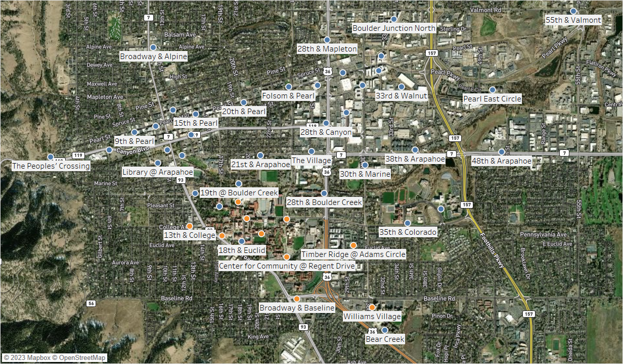
EDA: Popular Stations
Notes:
I’ll cover a few EDA results that were used in our modeling.
Starting with the popular stations:
There were a total of 54 stations located throughout the city

Slide 13
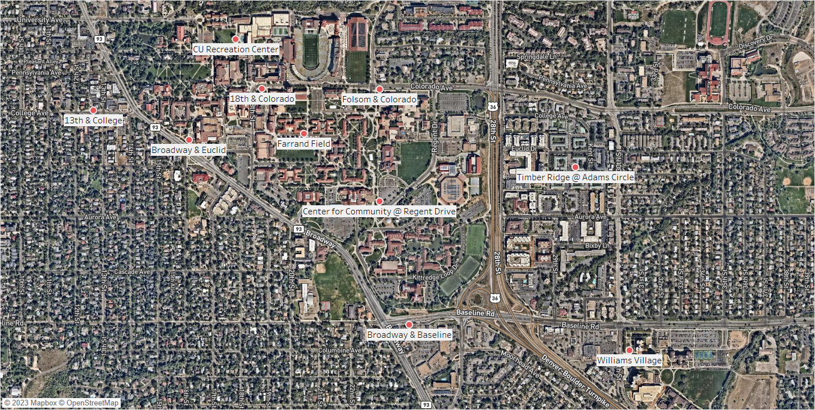
EDA: Popular Stations
Notes:
Out of which these are the top 10 stations based on usage frequency and stations which reported out of bike most number of times.
One who's familiar with the map can realize that most of these stations are located close to hotspots of CU Campus. Like the library, Rec Center, Engineering building, C4C, Will Vill campus etc
We have filtered out only these popular stations for our analysis.

Slide 14
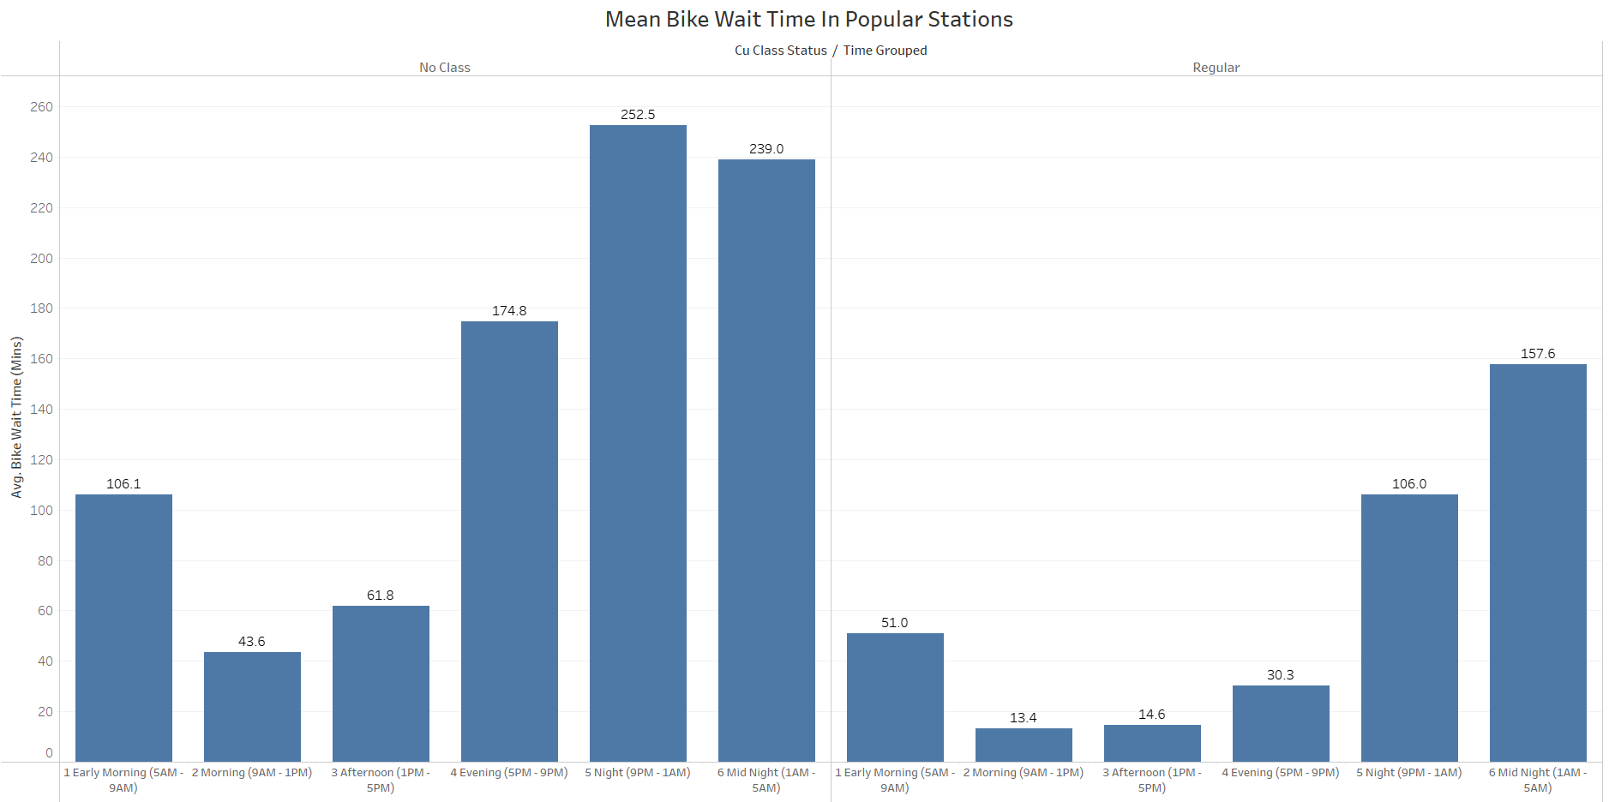
EDA: Morning – Evening on Regular class days are the busiest
Support Vector Machine
XGBoost Classifier
Random Forest Classifier
Notes:
These are the average wait time among the popular stations split by time of the day and CU Class status.
Notice that the stations are very busy between Morning – Evening especially on days when there were regular classes happening.
We used this information to split our result and compare the accuracy of busy and unbusy times. Ideally, we aimed to have high accuracy during busy times as that is when stations go empty.

Slide 15



Modeling
Hyperparameter Tuning
Support Vector Machine
XGBoost Classifier
Random Forest Classifier
Cross Validation
Notes:
For modeling we experimented with 3 classification models: SVM, XGBoost and Random Forest.
The initial accuracy was better in Random Forest.

Slide 16
Modeling
Support Vector Machine
Random Forest Classifier
Hyperparameter Tuning
Cross Validation
XGBoost Classifier
Notes:
Later, we improved the accuracy with hyperparameter tuning and cross validation on the RF classifier.

Slide 17
Results
Support Vector Machine
Random Forest Classifier
Hyperparameter Tuning
Cross Validation
XGBoost Classifier
Notes:
We trained the model using data until end of November and tested it on December first week data-
We achieved an accuracy 66% in the December overall. But as mentioned in the previous slides, we also checked the accuracy during the busiest time of the day (morning – evening on regular class days) and it was 75%.
Moreover, we noticed that the variance of wait time among stations were very different among stations. So that will definitely influence the model’s prediction. Hence, when we split the 75% accuracy among stations, we noticed that stations with less wait variance recorded high accuracy. And this is the list- few stations recorded an accuracy above 80% with the highest in C4C with 89%.
More than accuracy. In this problem statement it is important to have high recall and precision for the “Very Low” Category. As that is the most important category that tells if a person should wait or not- so we want the model to predict that category accurately. And we recorded a decent recall and precision score of __ and ___ respectively.

Slide 18
Conclusion
Notes:
* The current model can be used to estimate the wait time among the top 10 popular stations, and it accurately predicts the very low category than other categories especially during the busiest times of the day.

Slide 19
Challenges and future work
Expand it to other stations and other locations.
Train the model to forecast better on winters.

Slide 20
Reach us out on our LinkedIn/email for collaboration on any mentioned future work.
Github repository
Tableau dashboard link

Slide 21
Sko Buffs!

